Slide 1
Wireless OBD-2 Diagnostic Tool with touchscreen
Zak Rowland
Senior Project Proposal

Slide 2
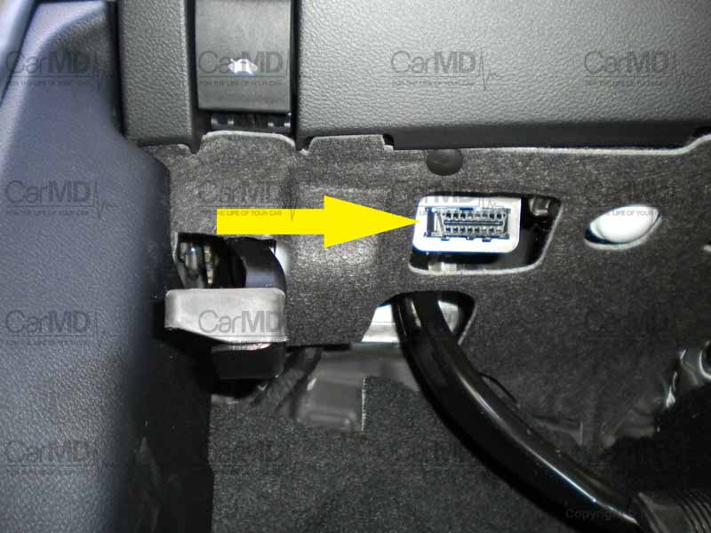
What is OBD-2?
Onboard Diagnostics (second version)
Used in vehicles since 1996
Diagnose “service engine” lights
Read information in real-time
source

Slide 3
My Solution
Small Bluetooth transmitter powered by the OBD-2 port to send data
Main unit that has a Bluetooth receiver to receive and process the data
Touchscreen, processor, and rechargeable battery also housed in main unit
Simple, user friendly interface
Basic functionality to keep costs low

Slide 4
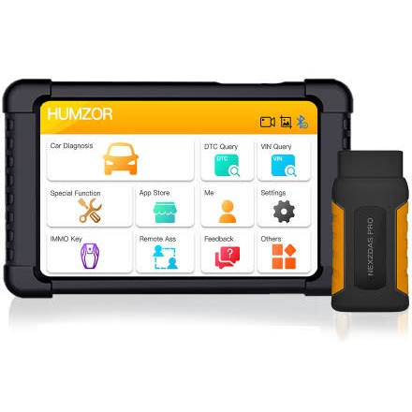
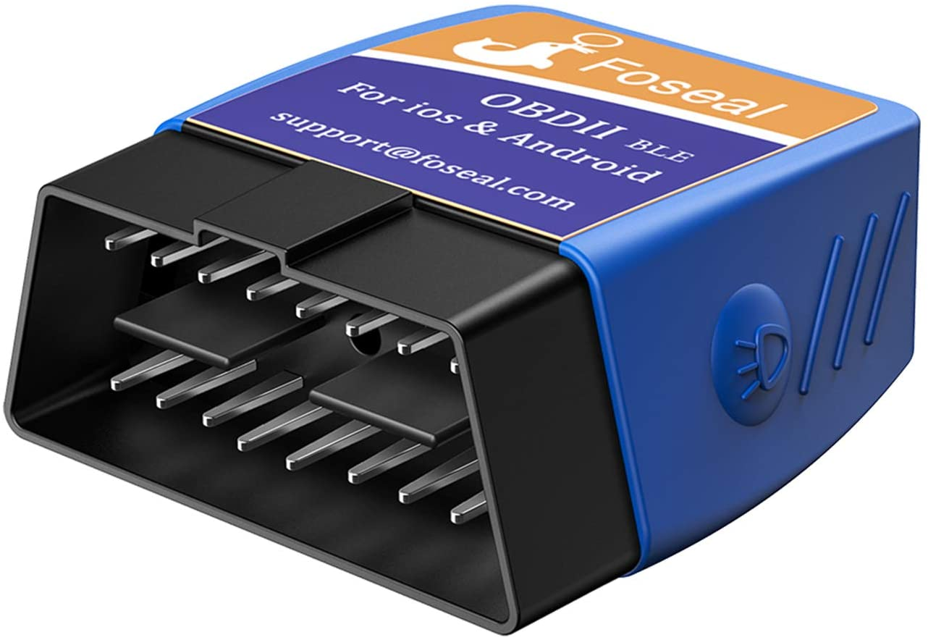
What about the current tools that exist?
There are little to no low/mid range costing Bluetooth diagnostic tools that use their own touchscreen
The devices that do cost around $200 and up
The low-cost Bluetooth readers connect to a phone app
source
source

Slide 5
How is my solution unique?
Primary focus is keeping cost low while retaining functionality
Accessible to as many as possible
Depending on platform used, could make most of the system open source

Slide 6
Anticipated Problems
Reading the OBD-2 port and making sense of the data
Transmitting the data via Bluetooth
Displaying the information on a screen
Processing touch input from user

